Slide 1
IBM CAPSTONE PROJECT – The Battle of Neighborhoods: Rrestaurants in Bangalore

Slide 2
Business Problem
• What is best location in Bangalore for Kerala Cuisine(or any other specific choice)
• Which areas have large number of Kerala Restaurant Market
• Which all areas have less number of Restaurant
• Which is the best place to stay if I prefer Kerala Cuisine
• What places are have best restaurant in Bangalore

Slide 3
Business Problem
How can a Bangalore resident find the best area where they can get large number of restaurants in their choice, or get the best restaurants area based on their choice?

Slide 4
Solution
Clustering Bangalore neighborhoods in order to recommend the areas where they can find the large number of restaurants in their choice or the area where they can find the best rated restaurants from the users preferred category.

Slide 5
Data and Methodology
Data: We use Zomato kaggel dataset for collecting the Bangalore restaurant data. We downloaded the dataset and use read_csv method to access the dataset and create dataframe from it. We use Geocoder for getting the latitude and Longitudes of all the locations received from the data set. We added the Latitude and longitude information for all the locations to the original data from by connecting it with location field. Using FourSquare API we find all venues for each neighbourhood and Filter out all venues that are nearby by locations. We Plot the data in bars using mathplotlib, for displaying the top ten highest rated Kerala restaurants area in Bangalore.We use aggregative rating for each restaurant to find the best places for Kerala restaurants. Visualise the Ranking of neighbourhoods in Maps using folium library..
Mehodology:
Collect Inspection Data;
Explore and Understand Data;
Data preparation and preprocessing;
Modeling – Kmeans Clustering

Slide 6
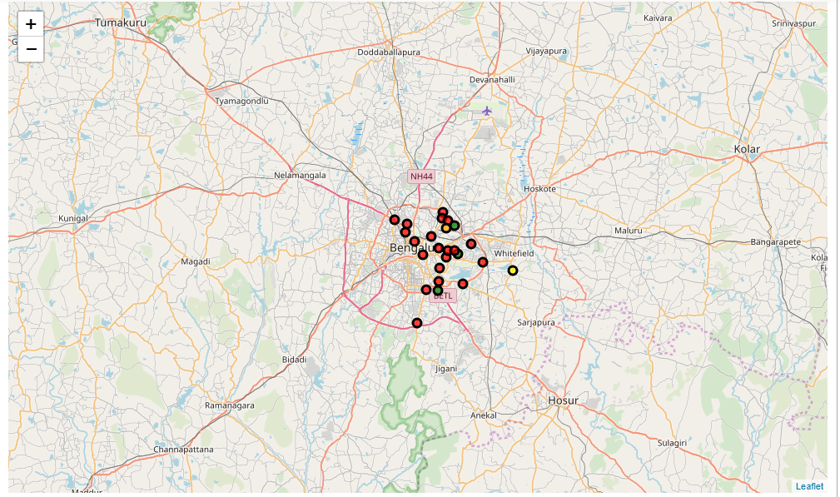
K-Means clustering

Slide 7
Outcome:
With the data now ready, we run k-means to cluster the neighborhoods into five (5) clusters. Examination of Restaurants data using Zomato Data Set for Bangalore for Kerala Restaurants, gives the below results
MG Road, Seshadripuram and Church Street are some of the best neighborhoods for Kerala cuisine.
Cunningham Road, Commercial Street and Sivajinagar are not great places for Kerala cuisine.
BTM Layout and Koramangala 1st block are the best localities for Kerala cuisine

